Slide 1



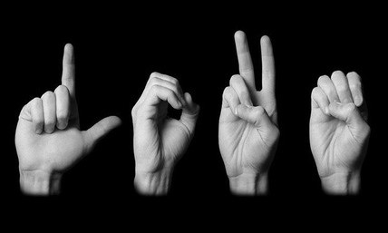
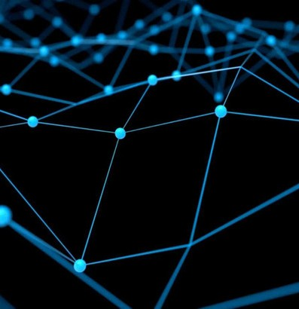
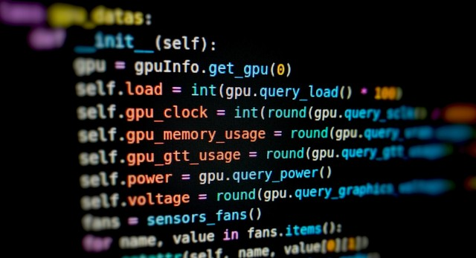
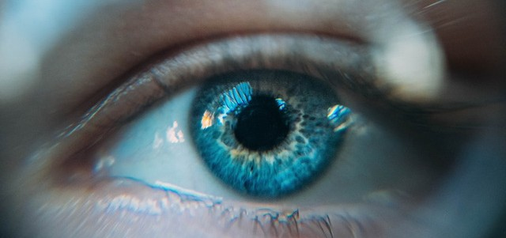
A system for sign language recognition

Slide 2
Team Members
Madhu Vani 319126510033
Bhanu Prakash 319126510039
S P Chandu 319126510059
Keerthi Priya 320126510L02
Guided By: N. Marline Joys Kumari

Slide 3

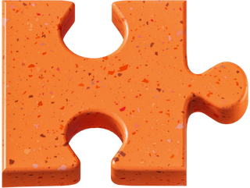
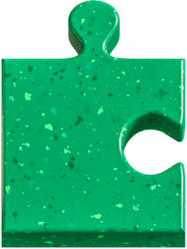
Communication is very crucial to human beings, as it enables us to express ourselves.
But there are some people who cannot express their views .They use sign language to communicate which cannot be understood by many people. This creates a gap between normal people and the disabled ones.
So in order to eliminate this communication barrier between them a system need to be introduced which converts sign language to text .
Problem Statement
A system for sign language recognition that classifies finger spelling can solve this problem.

Slide 4
Sign
Sign language is a natural and visual form of language that uses movements and expression to convey meaning between people.
Language
No person or committee invented sign language.
Different countries have different sign languages.
Sign language is a visual language.
Sign languages have their own grammar.

Slide 5
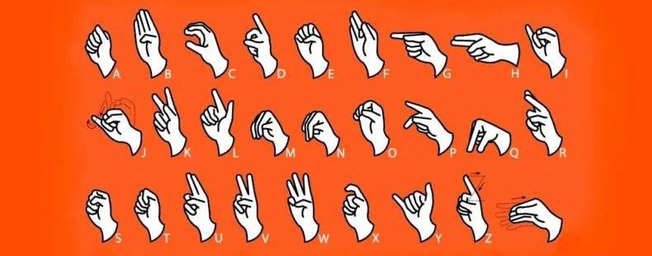
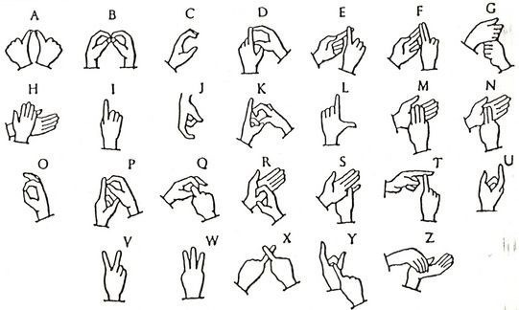
ASL(American Sign Language)
ISL(Indian Sign Language)

Slide 6
Proposed System
The proposed model rectifies the problem of existing system by converting signs into English characters and then to speech.
Sign language to text:
This system converts a stream of input hand gestures to their relevant semantic text using Tensorflow object detection.
Text to Speech :
This system uses Google text to Speech API which converts text into natural sounding speech.
xdcefrtgyhuji8k

Slide 7
How proposed system different from existing system?
The existing system for understanding the sign language is only based on sign-to-text feature. There is no speech feature available.
Our proposed idea is to enhance the existing system by not only with the sign-to-text feature but also text-to-speech.
In such a way normal people can both see the signs as well as hear the sounds. So it will be easier for us to communicate with them.

Slide 8
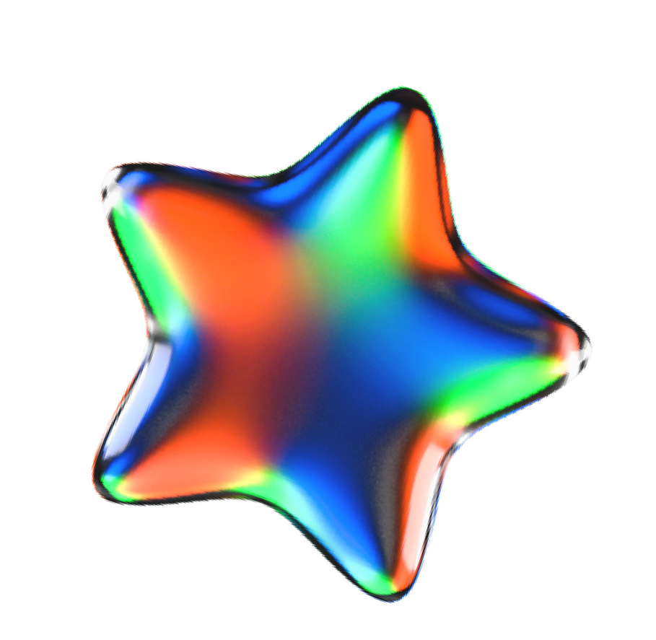
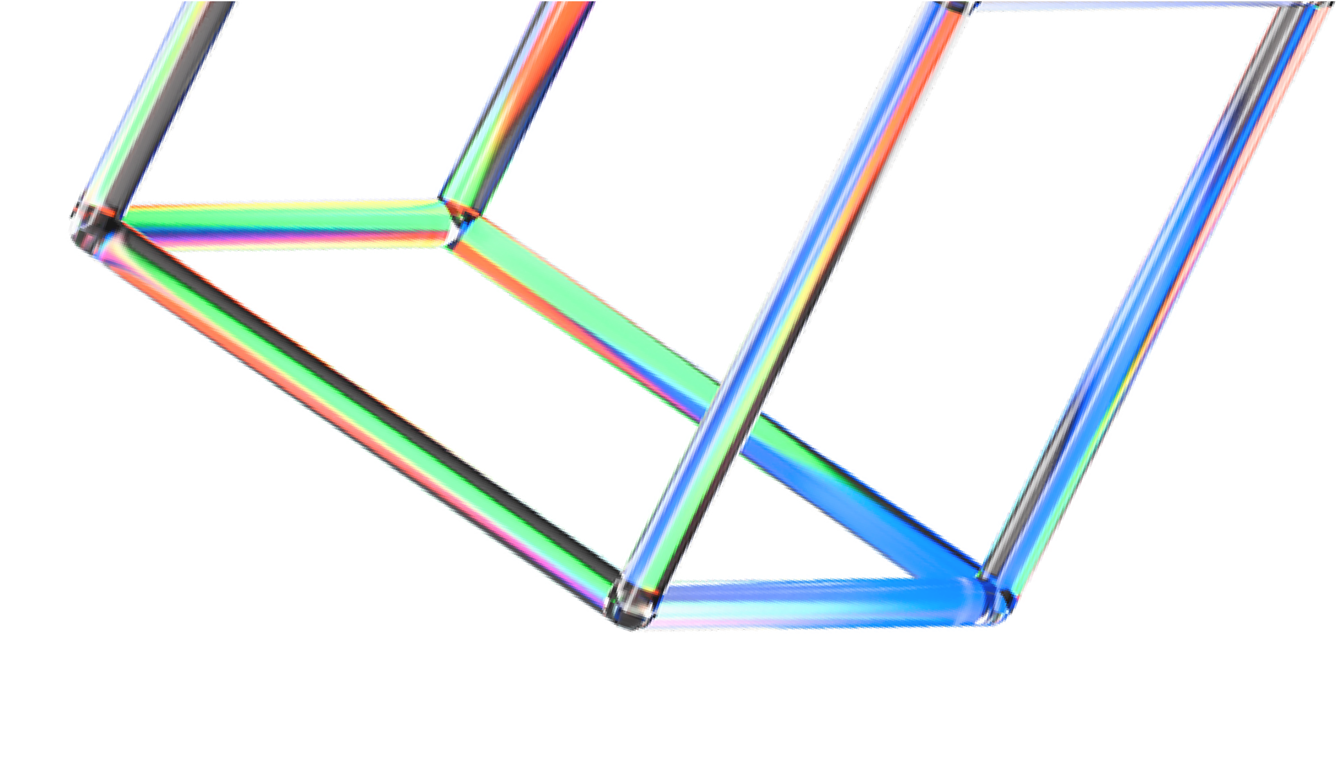




Technologies
Python (3.7.4)
a computer programming language often used to build websites and software, automate tasks, and conduct data analysis.
IDE (Jupyter)
an open source web application that you can use to create and share documents that contain live code, equations, visualizations, and text.
Keras (version 2.3.1)
a high-level, deep learning API developed by Google for implementing neural networks.
cv2 (openCV) (version 3.4.2)
open-source library for the computer vision, machine learning, and image processing
Tensorflow (version2.0.0)
an open-source library developed by Google primarily for deep learning applications.

Slide 9


How CNNs Work
 | Convolution puts the input images through a set of convolutional filters, each of which activates certain features from the images.
 | Rectified linear unit (ReLU) allows for faster and more effective training by mapping negative values to zero and maintaining positive values.
 | Pooling simplifies the output by performing nonlinear downsampling, reducing the number of parameters that the network needs to learn.
Rectified linear unit (ReLU) allows for faster and more effective training by mapping negative values to zero and maintaining positive values.
Pooling simplifies the output by performing nonlinear downsampling, reducing the number of parameters that the network needs to learn
After learning features in many layers, the architecture of a CNN shifts to classification.

Slide 10
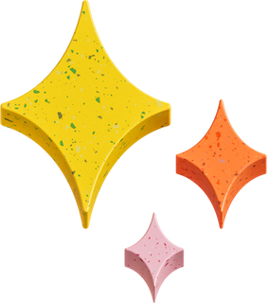
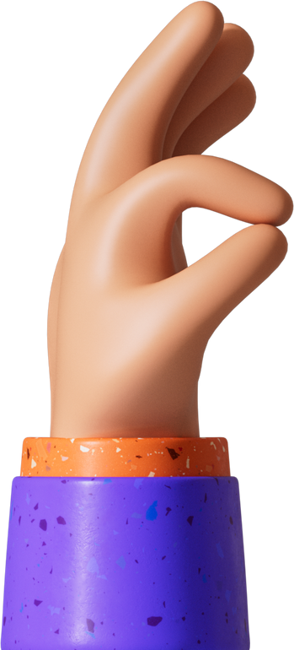
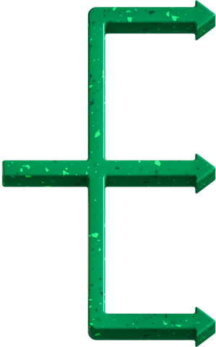
Stakeholders of the project
Deaf people
Non verbal people
Hard-of-hearing and hearing individuals, especially the children of Deaf adults.

Slide 11


